Slide 1

Future
Exploring the Next Frontier in QCD: The Electron-Ion Collider
Rolf Ent
GaryFest aka Transverse Spin Phenomena and Their Impact on QCD Workshop, Jefferson Lab, 10/29/2010
The Electron-Ion Collider
  - The EIC project
  - The EIC science
EIC Roadmap
Conclusions

Slide 2

A High-Luminosity Electron Ion Collider
NSAC 2007 Long-Range Plan:
“An Electron-Ion Collider (EIC) with polarized beams has been embraced by the U.S. nuclear science community as embodying the vision for reaching the next QCD frontier. EIC would provide unique capabilities for the study of QCD well beyond those available at existing facilities worldwide and complementary to those planned for the next generation of accelerators in Europe and Asia.”
Base EIC Requirements:
    range in energies from s = few 100 to s = few 1000 & variable
    fully-polarized (>70%), longitudinal and transverse
    ion species up to A = 200 or so
    high luminosity: about 10³⁴ e-nucleons cm⁻² s⁻¹
    upgradable to higher energies

Slide 3
Why an Electron-Ion Collider?
Longitudinal and Transverse Spin Physics!
    70+% polarization of beam and target without dilution
    transverse polarization also 70%!
Detection of fragments far easier in collider environment!
    fixed-target experiments boosted to forward hemisphere
    no fixed-target material to stop target fragments
    access to neutron structure w. deuteron beams (@ p_{m} = 0!)
Easier road to do physics at high CM energies!
    E_{cm}² = s = 4E₁E₂ for colliders, vs. s = 2ME for fixed-target
    → 4 GeV electrons on 12 GeV protons ~ 100 GeV fixed-target
    Easier to produce many J/Ψ’s, high-p_{T} pairs, etc.
    Easier to establish good beam quality in collider mode
Longitudinal polarization FOM
Target | f_{dilution, fixed_target} | P_{fixed_target} | f²P²_{fixed_target} | f²P²_{EIC}
p | 0.2 | 0.8 | 0.03 | 0.5
d | 0.4 | 0.5 | 0.04 | 0.5

Slide 4
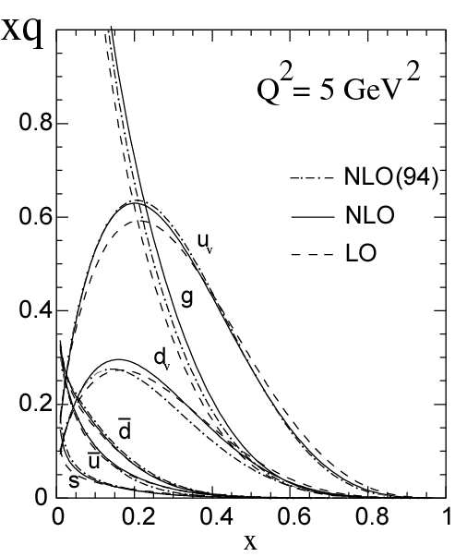

EIC@JLab High-Level Science Overview
Hadrons in QCD are relativistic many-body systems, with a fluctuating number of elementary quark/gluon constituents and a very rich structure of the wave function.
With 12 GeV we study mostly the valence quark component, which can be described with methods of nuclear physics (fixed number of particles).
With an (M)EIC we enter the region where the many-body nature of hadrons, coupling to vacuum excitations, etc., become manifest and the theoretical methods are those of quantum field theory. An EIC aims to study the sea quarks, gluons, and scale (Q²) dependence.
12 GeV

Slide 5
Nuclear Physics – 12 GeV to EIC
Study the Force Carriers of QCD
The role of Gluons and Sea Quarks

Slide 6
Current Ideas for a Collider
Design Goals for Colliders Under Consideration World-wide
 | Energies | s | Design Luminosity
(M)EIC@JLab | Up to 11 x 60+ | 240-3000+ | Close to 10³⁴
Future ELIC@JLab | Up to 11 x 250 (20? x 250) | 11000 (20000?) | Close to 10³⁵
Staged MeRHIC@BNL | Up to 5 x 250 | 600-5000 | Close to 10³⁴
eRHIC@BNL | Up to 20 x 325 (30 x 325) | 26000 (39000) | Close to 10³⁴
ENC@GSI | Up to 3 x 15 | 180 | Few x 10³²
LHeC@CERN | 60 x 7000 (140x7000) | 1680000 (3920000) | Close to 10³³
Present focus of interest (in the US) are the (M)EIC and Staged MeRHIC versions, with s up to ~4000 and 5000, resp.

Slide 7



5 GeV e x 250 GeV p – 100 GeV/u Au
MeRHIC - Concept
s = 600 - 5000
Vertically separated
recirculating passes.
# of passes will be chosen
to optimize eRHIC cost
eRHIC detector
injector
2 Superconducting RF linacs
1 → 5 GeV per pass
4 (or 6) passes
Coherent
e-cooler
eRHIC-I → eRHIC: energy of electron beam is increased from 5 GeV to 30 GeV by building up the linacs
PHENIX → ePHENIX
STAR → eSTAR
ePHENIX
RHIC: 325 GeV p
or 130 GeV/u Au with DX magnets removed
MeRHIC
Medium Energy eRHIC
  @ IP12 of RHIC
  5 GeV e⁻ x 50-250 GeV p
  L ~ 10³³-10³⁴ cm⁻² sec ⁻¹
eSTAR

Slide 8
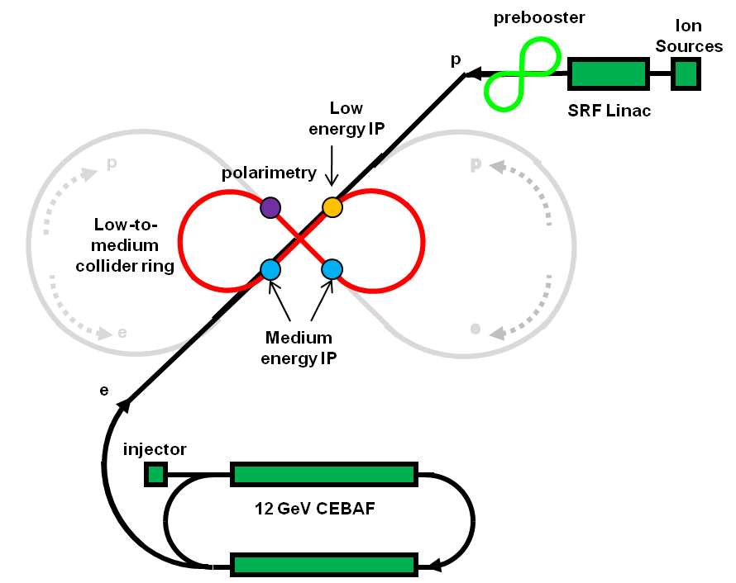
A High-Luminosity EIC at JLab - Concept
E_{cm}² = s = 4E_{e}E_{p}
E_{e} = 3 – 11 GeV
(upgradeable to 20+ GeV)
E_{p} = 20 – 60+ GeV
(12 GeV injection energy)
(upgradeable to 250 GeV)
Legend:
(M)EIC@JLab
1 low-energy IP (s ~ 300)
2 medium-energy IPs (s < 4000)
ELIC = high-energy EIC@JLab
(s = 20000?)
(E_{p} ~ 250 limited by JLab site)
Use CEBAF “as-is” after 12-GeV Upgrade

Slide 9
The Science of an (M)EIC
Nuclear Science Goal: How do we understand the visible matter in our universe in terms of the fundamental quarks and gluons of QCD?
Overarching EIC Goal: Explore and Understand QCD
Three Major Science Questions for an EIC (from NSAC LRP07):
What is the internal landscape of the nucleons?
What is the role of gluons and gluon self-interactions in nucleons and nuclei?
What governs the transition of quarks and gluons into pions and nucleons?
Or, Elevator-Talk EIC science goals:
Map the spin and spatial structure of quarks and guons in nucleons
(show the nucleon structure picture of the day…)
Discover the collective effects of gluons in atomic nuclei
(without gluons there are no protons, no neutrons, no atomic nuclei)
Understand the emergence of hadronic matter from quarks and gluons
(how does E = Mc² work to create pions and nucleons?)
+ Hunting for the unseen forces of the universe?

Slide 10
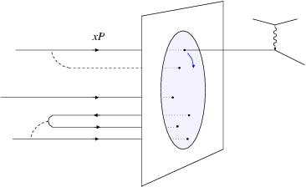
Why a New-Generation EIC?
Obtain detailed differential transverse quark and gluon images
(derived directly from the t dependence with good t resolution!)
    Gluon size from J/Ψ and φ electroproduction
    Singlet quark size from deeply virtual compton scattering (DVCS)
    Strange and non-strange (sea) quark size from π and K production
Determine the spin-flavor decomposition of the light-quark sea
Constrain the orbital motions of quarks & anti-quarks of different flavor
    - The difference between π⁺, π–, and K⁺ asymmetries reveals the orbits
Map both the gluon momentum distributions of nuclei (F₂ & F_{L} measurements)
and the transverse spatial distributions of gluons on nuclei
(coherent DVCS & J/Ψ production).
At high gluon density, the recombination
of gluons should compete with gluon
splitting, rendering gluon saturation.
Can we reach such state of saturation?
Explore the interaction of color charges
with matter and understand the
conversion of quarks and gluons to
hadrons through fragmentation and
breakup.
longitudinal momentum
orbital motion
quark to hadron conversion
Dynamical structure!
Gluon saturation?
transverse distribution

Slide 11
The Science of an (M)EIC
Or, Elevator-Talk EIC science goals:
Map the spin and spatial structure of quarks and guons in nucleons
(show the nucleon structure picture of the day…)
Discover the collective effects of gluons in atomic nuclei
(without gluons there are no protons, no neutrons, no atomic nuclei)
Understand the emergence of hadronic matter from quarks and gluons
(how does E = Mc² work to create pions and nucleons?)
+ Hunting for the unseen forces of the universe?

Slide 12
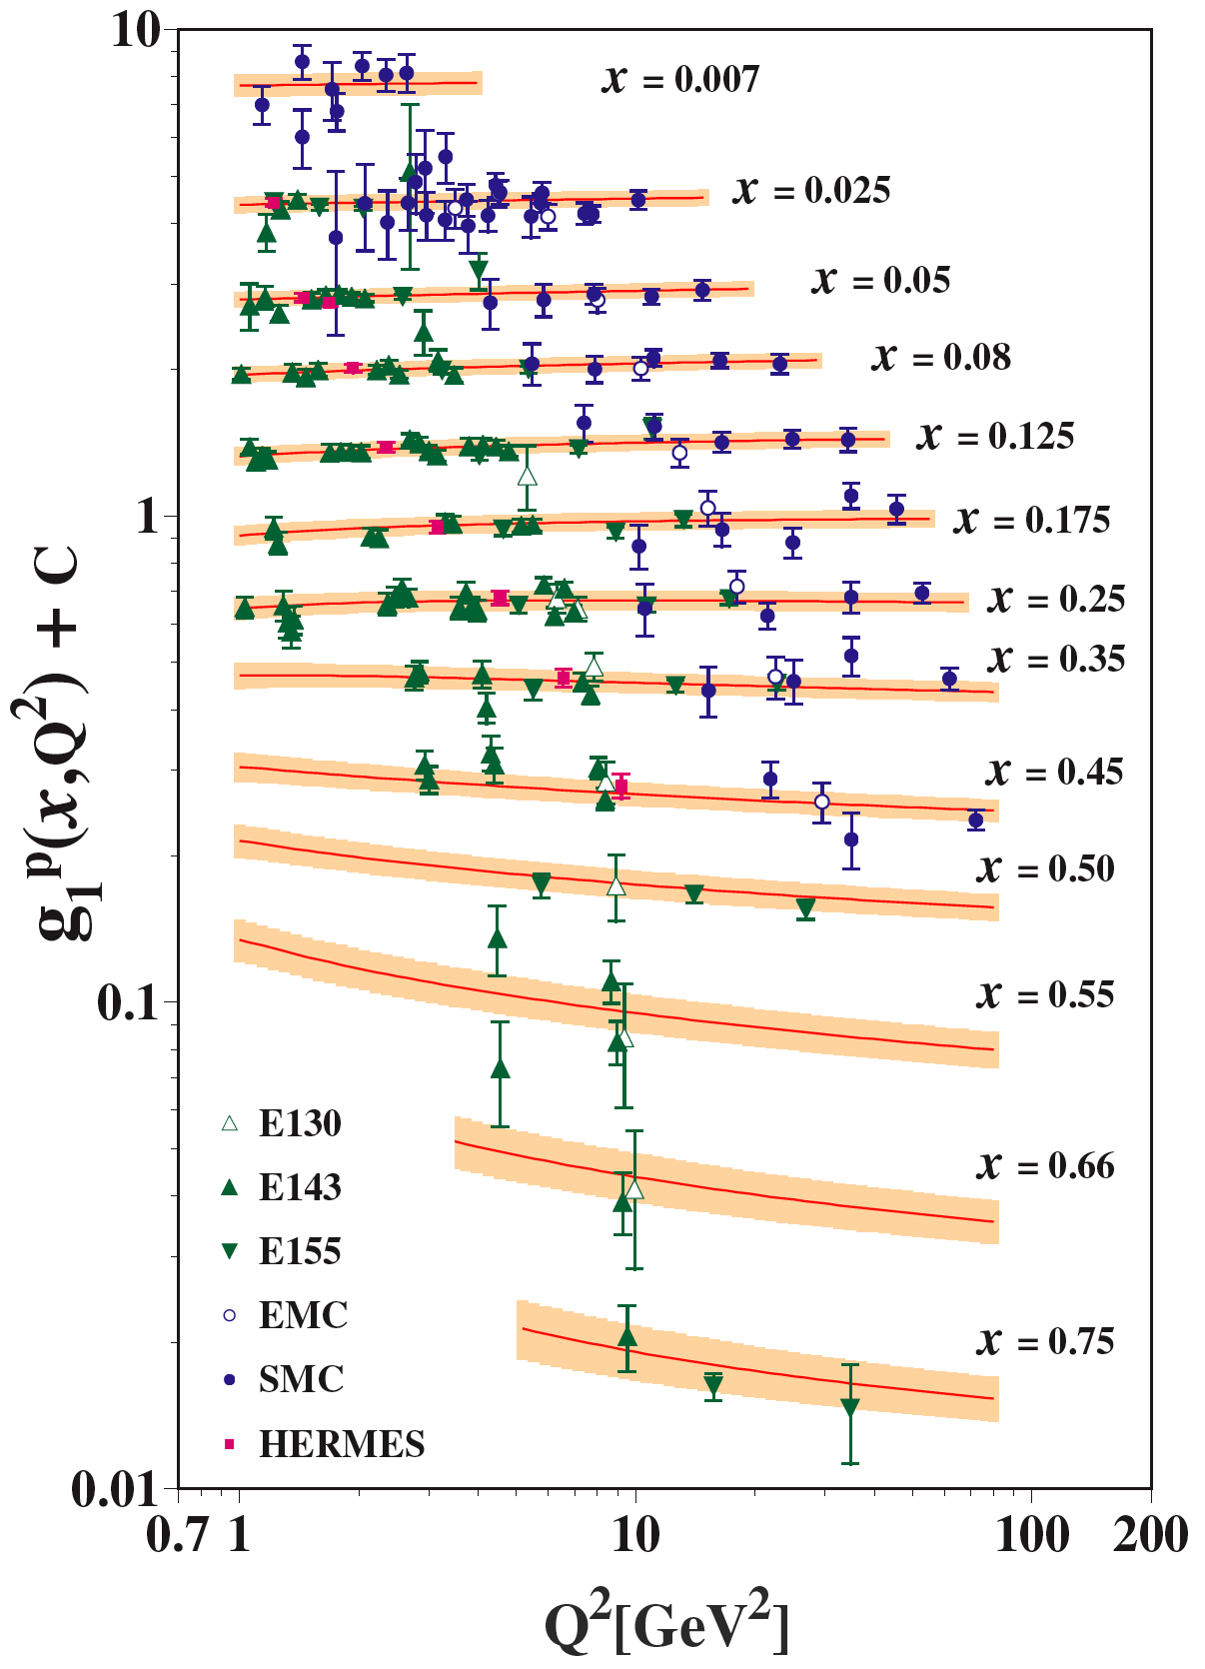
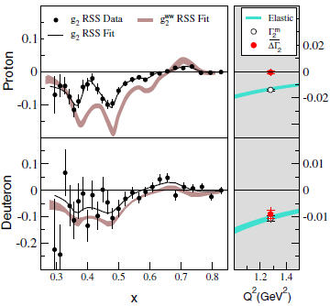
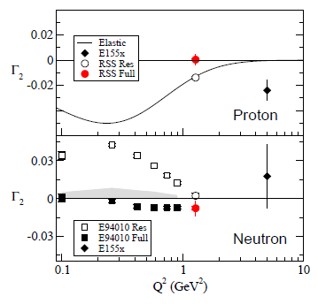
World Data on g₁^{p}
World Data on g₂^{p&n}
soon
soon
30% of proton spin carried by quark spin

Slide 13
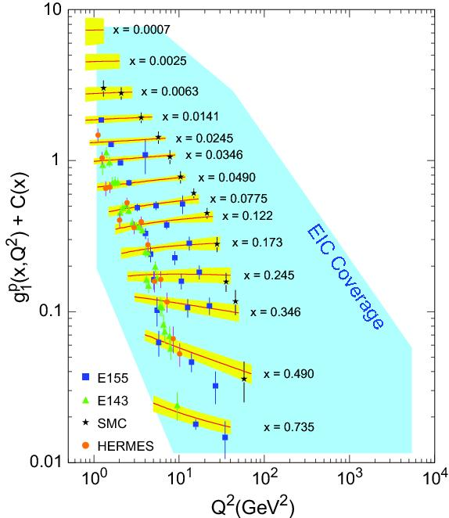
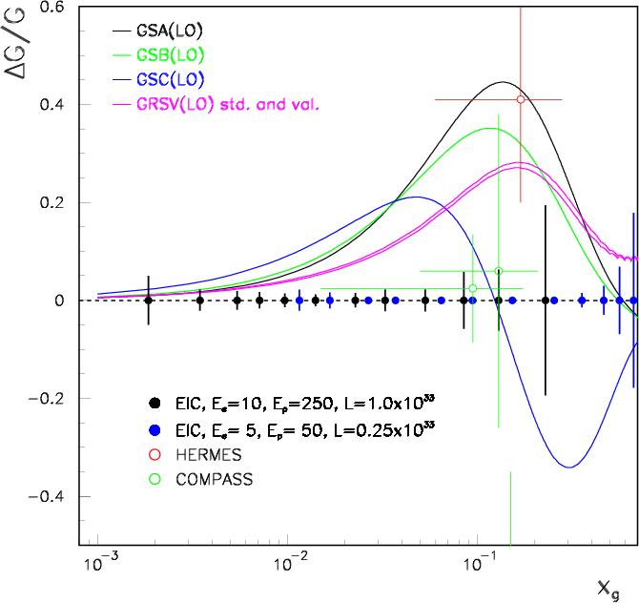
Projected g₁^{p} Landscape of the EIC
Access to Δg/g is possible from the g₁^{p} measurements through the QCD evolution, or from open charm (D⁰) production (see below), or from di-jet measurements.
RHIC-Spin
Similar for g₂^{p} (and g₂^{n})!

Slide 14
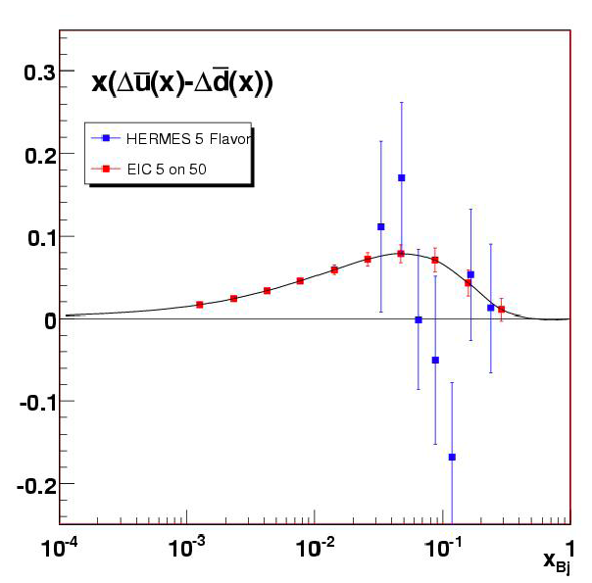
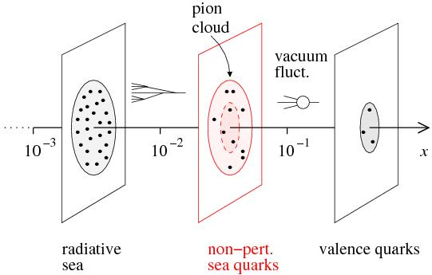
Sea Quark Polarization
Spin-Flavor Decomposition of the Light Quark Sea
}
100 days, L =10³³, s = 1000
Access requires s ~ 1000 (and good luminosity)
u
u
u
Many models predict
Δu > 0, Δd < 0
>
u
d
| p = + + + …
u
u
u
u
d
d
d
d

Slide 15



Beyond form factors and quark distributions –
Generalized Parton Distributions (GPDs)
X. Ji, D. Mueller, A. Radyushkin (1994-1997)
Proton form factors, transverse charge & current densities
Structure functions,
quark longitudinal
momentum & helicity
distributions
Correlated quark momentum
and helicity distributions in
transverse space - GPDs
Extend longitudinal quark momentum & helicity distributions to transverse momentum distributions - TMDs
2000’s

Slide 16
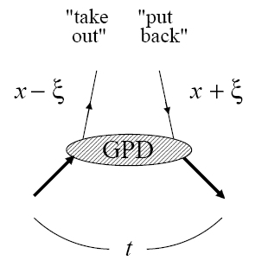
Transverse Quark & Gluon Imaging
Deep exclusive measurements in ep/eA with an EIC:
diffractive: transverse gluon imaging J/ψ, φ, ρº, γ (DVCS)
non-diffractive: quark spin/flavor structure π, K, ρ⁺, …
Are gluons uniformly distributed in nuclear matter or are there small clumps of glue?
Are gluons & various quark flavors similarly distributed?
(some hints to the contrary)
Describe correlation of longitudinal momentum and transverse position of quarks/gluons →
Transverse quark/gluon imaging of nucleon
(“tomography”)

Slide 17
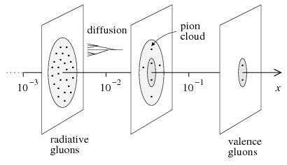

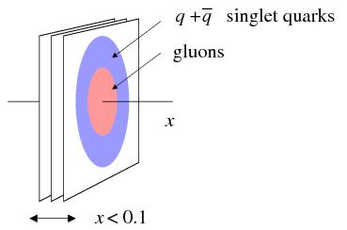
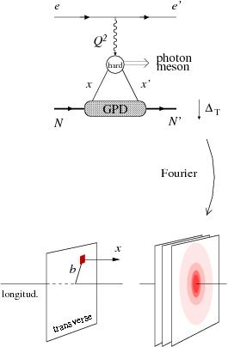
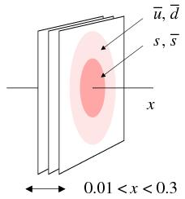
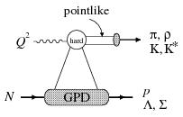
Detailed differential images from nucleon’s partonic structure
EIC: Gluon size from J/Ψ and φ electroproduction (Q² > 10 GeV²)
t
[Transverse distribution derived directly from t dependence]
Hints from HERA:
Area (q + q) > Area (g)
Dynamical models predict difference:
pion cloud, constituent quark picture
-
EIC: singlet quark size from deeply virtual compton scattering
t
Q² > 10 GeV²
for factorization
Statistics hungry
at high Q²!
EIC: strange and non-strange (sea) quark size from π and K production

Slide 18
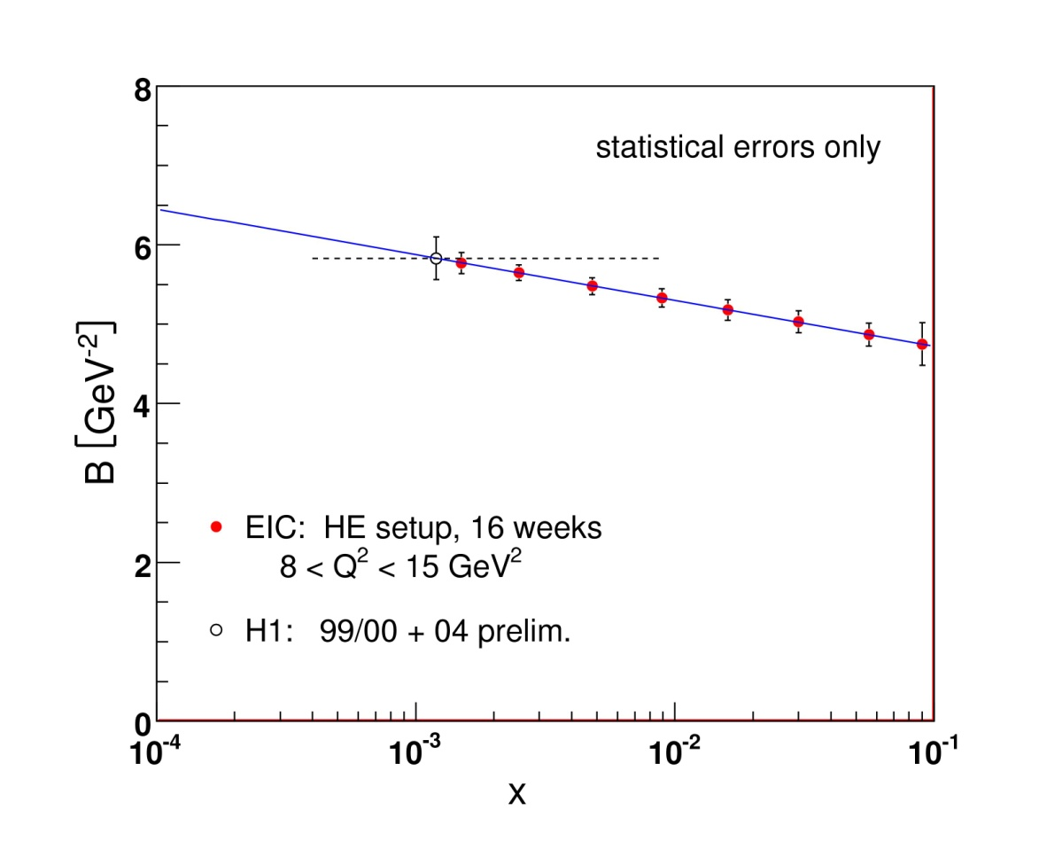
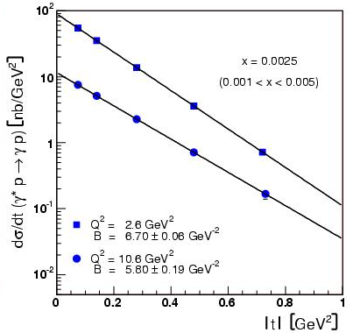

GPDs and Transverse Gluon Imaging
Goal: Transverse gluon imaging of nucleon over wide range of x: 0.001 < x < 0.1
Requires: - Q² ~ 10-20 GeV² to facilitate interpretation
- Wide Q², W² (x) range
- luminosity of 10³³ (or more) to do differential measurements in Q², W², t
Q² = 10 GeV² projected data
EIC enables gluon imaging!
Simultaneous data at other Q²-values
(Andrzej Sandacz)

Slide 19
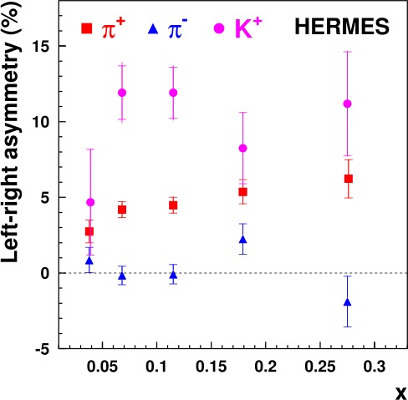
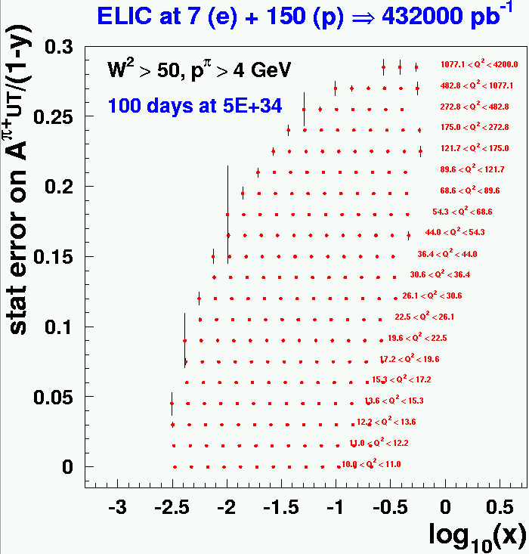
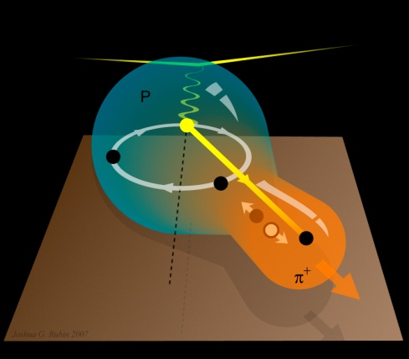
The road to orbital motion
Swing to the left, swing to the right:
A surprise of transverse-spin experiments
The difference between the π⁺, π–, and K⁺ asymmetries reveals that quarks and anti-quarks of different flavor are orbiting in different ways within the proton.
An EIC with high transverse polarization is the optimal tool to to study this!
Illustration of the possible correlation between the internal motion of an up quark and the direction in which a positively-charged pion (ud) flies off.
-

Slide 20

Single-Spin Asymmetry Projections with Proton
  11 + 60 GeV
  36 days
  L = 3x10³⁴ /cm²/s
2x10⁻³ , Q²<10 GeV²
4x10⁻³ , Q²>10 GeV²
3 + 20 GeV
36 days
L = 1x10³⁴/cm²/s
3x10⁻³ , Q²<10 GeV²
7x10⁻³ , Q²>10 GeV²
Polarization 80%
Overall efficiency 70%
  z: 12 bins 0.2 - 0.8
  P_{T}: 5 bins 0-1 GeV
  (Also π⁻)
φ_{h} angular coverage incuded
Average of Collins/Sivers/Pretzelosity projections
Still with θ_{h} <40 cut, needs to be updated

Slide 21
The Science of an (M)EIC
Or, Elevator-Talk EIC science goals:
Map the spin and spatial structure of quarks and guons in nucleons
(show the nucleon structure picture of the day…)
Discover the collective effects of gluons in atomic nuclei
(without gluons there are no protons, no neutrons, no atomic nuclei)
Understand the emergence of hadronic matter from quarks and gluons
(how does E = Mc² work to create pions and nucleons?)
+ Hunting for the unseen forces of the universe?

Slide 22
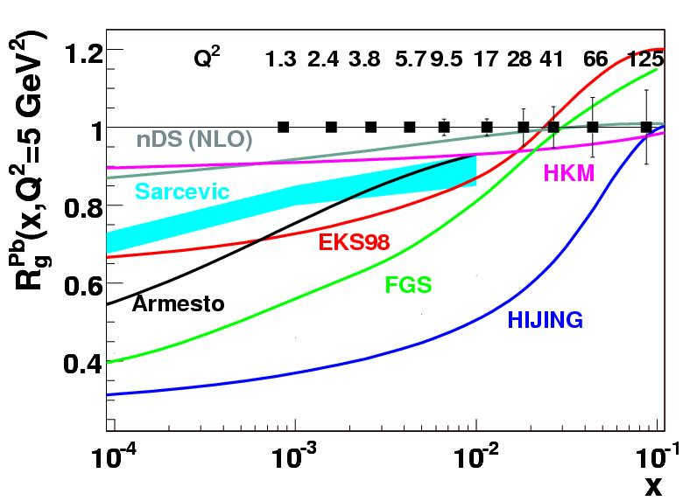
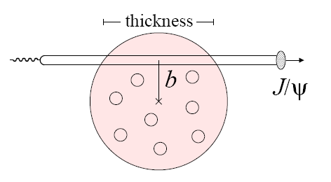
Gluons in Nuclei
Ratio of gluons in lead to deuterium
What do we know about
gluons in a nucleus?
NOTHING!!!
Large uncertainty in gluon distributions
need range of Q² in shadowing region, → x ~ 10⁻²-10⁻³ → s_{EIC} = 1000+
+ Transverse distribution of gluons on nuclei from coherent Deep-Virtual Compton Scattering and coherent J/Ψ production
[Measurements at DESY of diffractive channels (J/ψ, φ, ρ, γ) confirmed the applicability of QCD factorization:
t-slopes universal at high Q² & flavor relations φ:ρ hold]
Gluon radius
of a nucleus?

Slide 23
The Science of an (M)EIC
Or, Elevator-Talk EIC science goals:
Map the spin and spatial structure of quarks and guons in nucleons
(show the nucleon structure picture of the day…)
Discover the collective of gluons in atomic nuclei
(without gluons there are no protons, no neutrons, no atomic nuclei)
Understand the emergence of hadronic matter from quarks and gluons
(how does E = Mc² work to create pions and nucleons?)
+ Hunting for the unseen forces of the universe?

Slide 24
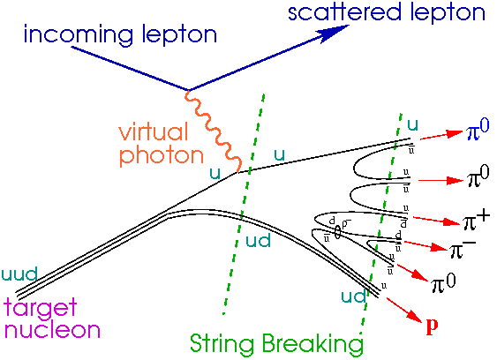
Hadronization
EIC: Understand the conversion of quarks and gluons to hadrons through fragmentation and breakup
un-integrated parton distributions
current
fragmentation
+η ∼ 2
EIC
Fragmentation from
QCD vacuum
target
fragmentation
-η ∼ −4
EIC: Explore the interaction of color charges with matter

Slide 25

Electron-Ion Collider – Roadmap
EIC (eRHIC/ELIC) webpage: http://web.mit.edu/eicc/
Weekly meetings at both BNL and JLab
    Wiki pages at http://eic.jlab.org/ & https://wiki.bnl.gov/eic
EIC Collaboration has biannual meetings since 2006
    Last EIC meeting: July 29-31, 2010 @ Catholic University, DC
INT10-03 program @ Institute for Nuclear Theory ongoing
spin, QCD matter, imaging, electroweak Sept. 10 – Nov. 19, 2010
Periodic EIC Advisory Committee meetings (convened by BNL & JLab)
After INT10-03 program (2011 – next LRP)
need to produce single, community-wide White Paper
laying out full EIC science program in broad, compelling strokes
and need to adjust EIC designs to be conform accepted energy- luminosity profile of highest nuclear science impact
followed by an apples-to-apples bottom-up cost estimate comparison
for competing designs, folding in risk factors
and folding in input from ongoing Accelerator R&D, EICAC and community

Slide 26
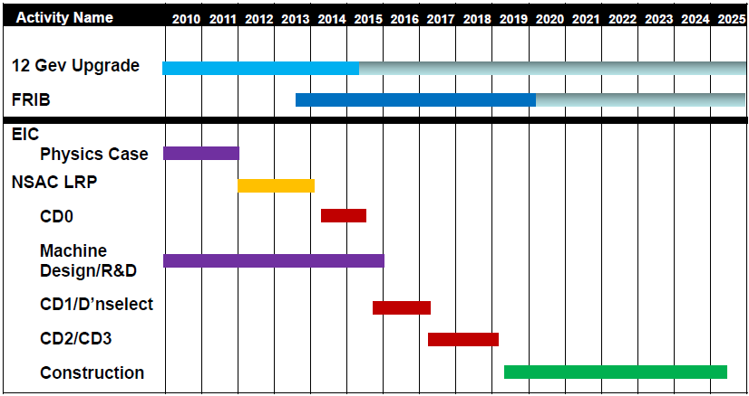
EIC Realization
From Hugh Montgomery’s presentation at the INT10-03 Program in Seattle
Assumes endorsement for an EIC at the next ~2012/13 NSAC Long Range Plan

Slide 27
GaryFest
“… in honor of Gary Goldstein's 70th Birthday to celebrate him and his many contributions to the fields of spin polarization phenomena, transversity, and heavy quark physics in QCD and hadronic physics.”
The EIC is the perfect laboratory to match Gary’s interest and multiple contributions.
Gary’s most recent work is on deeply virtual exclusive processes with charm at an EIC… … ending with announcement of further work on multiple spin correlation observables in hyperon production ☺ Happy 70th birthday!

Slide 28
Appendix

Slide 29
EIC@JLab assumptions
(x,Q²) phase space directly correlated with s (=4E_{e}E_{p}) :
@ Q² = 1 lowest x scales like s⁻¹
@ Q² = 10 lowest x scales as 10s⁻¹
x = Q²/ys
General science assumptions:
(“Medium-Energy”) EIC@JLab option driven by:
access to sea quarks (x > 0.01 (0.001?) or so)
deep exclusive scattering at Q² > 10 (?)
any QCD machine needs range in Q²
→ s = few 100 - 1000 seems right ballpark
→ s = few 1000 allows access to gluons, shadowing
Requirements for deep exclusive and high-Q² semi-inclusive reactions also drives request for (lower &) more symmetric beam energies.
Requirements for very-forward angle detection folded in Interaction Region design from the start

Slide 30
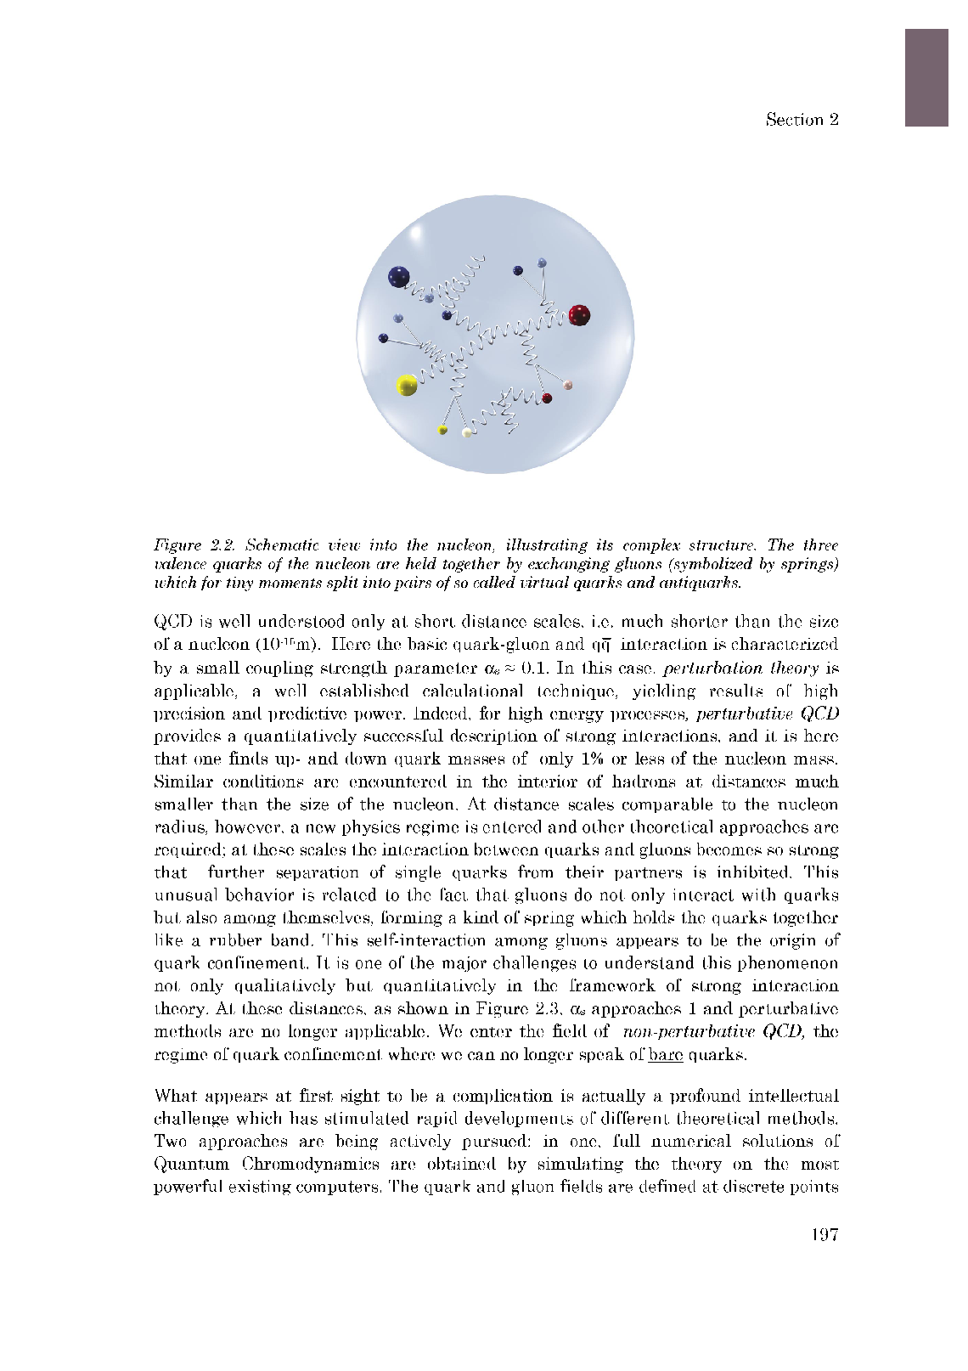
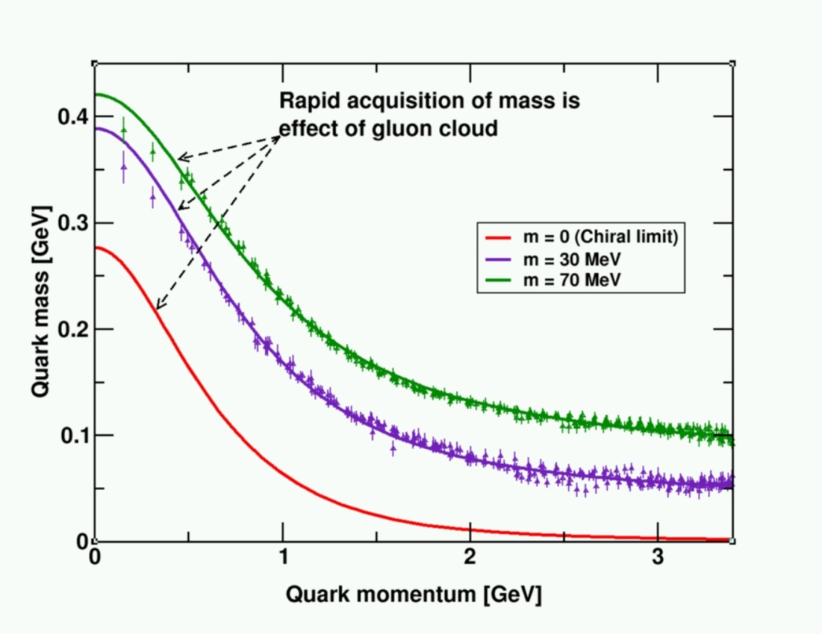
QCD and the Origin of Mass
99% of the proton’s mass/energy is due to the self-generating gluon field
  Higgs mechanism has almost no role here.
The similarity of mass between the proton and neutron arises from the fact that the gluon dynamics are the same
  Quarks contribute almost nothing.

Slide 31
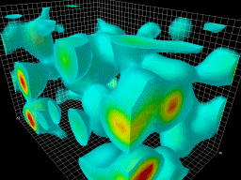
Gluons and QCD
QCD is the fundamental theory that describes structure and interactions in nuclear matter.
Without gluons there are no protons, no neutrons, and no atomic nuclei
Gluons dominate the structure of the QCD vacuum
Facts:
  The essential features of QCD (e.g. asymptotic freedom, chiral symmetry breaking, and color confinement) are all driven by the gluons!
  Unique aspect of QCD is the self interaction of the gluons
  99% of mass of the visible universe arises from glue
  Half of the nucleon momentum is carried by gluons

Slide 32
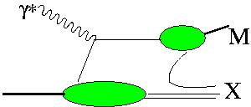
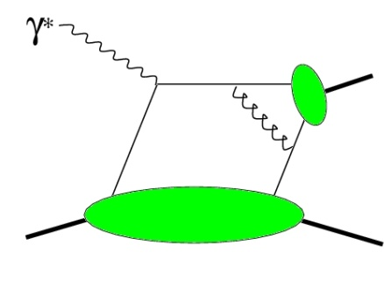
Towards a “3D” spin-flavor landscape
W^{u}(x,k,r)
(Wigner Function)
m
m
d³r
d²k_{T}
p
x
p
TMD
GPD
B
Transverse-Momentum Dependent Parton Distributions
TMD^{u}(x,k_{T})
f₁,g₁,f_{1T} ,g_{1T}
h₁, h_{1T} , h_{1L} , h₁
Link to Orbital Momentum
GPD^{u}(x,ξ,t)
H^{u}, E^{u}, H^{u}, E^{u}
Link to Orbital Momentum
Generalized Parton Distributions
~
~
Want P_{T} > Λ but not too large!
d²k_{T}
ξ = 0, t = 0
dx
f₁(x)
g₁, h₁
u(x)
Δu, δu
F₁^{u}(t)
F₂^{u},G_{A}^{u},G_{P}^{u}
Parton Distributions
Form Factors

Slide 33
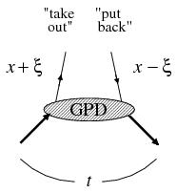
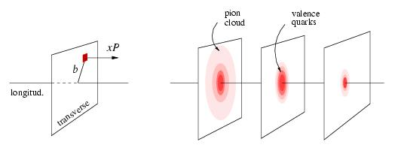
What’s the use of GPDs?
1. Allows for a unified description of form factors and parton distributions
2. Describe correlations of quarks/gluons
3. Allows for Transverse Imaging
Fourier transform in momentum transfer
x < 0.1
x ~ 0.3
x ~ 0.8
gives transverse spatial distribution of quark (parton) with momentum fraction x
4. Allows access to quark angular momentum (in model-dependent way)

Slide 34
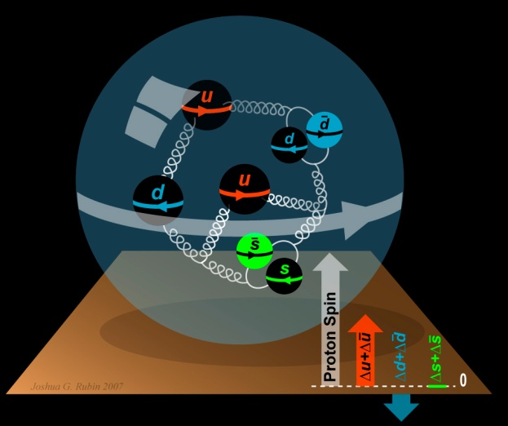
Where does the spin of the proton originate? (let alone other hadrons…)
The Standard Model tells us that spin arises from the spins and orbital angular momentum of the quarks and gluons:
½ = ½ ΔΣ + ΔG + L
Experiment: ΔΣ ≈ 0.3
Gluons contribute to much of the mass and ≈ half of the momentum of the proton, but…
… recent results (RHIC-Spin, COMPASS@CERN) indicate that their contribution to the proton spin is small: ΔG < 0.1?
(but only in small range of x…)
L_{u}, L_{d}, L_{g}?

Slide 35

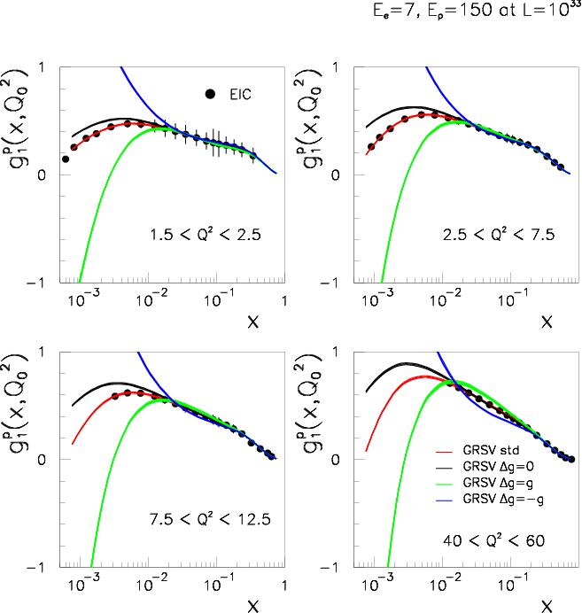
The Gluon Contribution to the Proton Spin
at small x
Superb sensitivity to Δg at small x!

Slide 36
EIC Project - Roadmap
Year | CEBAF Upgrade | Electron-Ion Colldier
1994 | 1st CEBAF at Higher Energies Workshop
1996 (LRP) | CEBAF Upgrade an Initiative
~2000 | Energy choice settled, “Golden Experiments” | 1st workshops on US Electron-Ion Collider
2002 (LRP) | JLab 12-GeV Upgrade 4th recommendation | Electron-Ion Collider an Initiative
2007 (LRP) | JLab 12-GeV Upgrade highest recommendation | Electron-Ion Collider “half-recommendation”
2010 |  | EIC “Golden Experiments”???
2013? (LRP) | JLab 12-GeV & FRIB construction highest recommendation? | EIC a formal (numbered) recommendation?
2015 | JLab 12-GeV Upgrade construction complete | EIC Mission Need, formal R&D ongoing?
2025? |  | EIC construction complete?

Slide 37

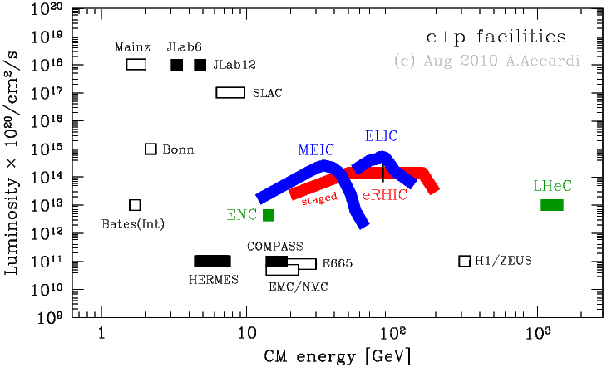
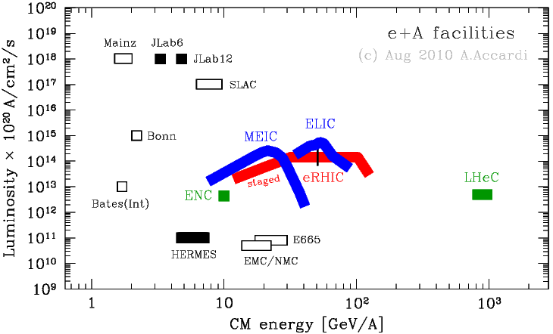
MEIC & ELIC: Luminosity Vs. CM Energy
e + p facilities
e + A facilities
https://eic.jlab.org/wiki/index.php/Machine_designs
Notes:
37

Slide 38
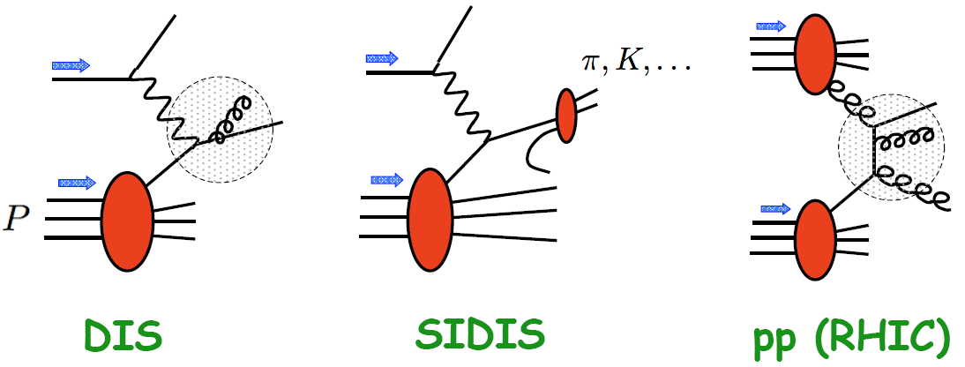
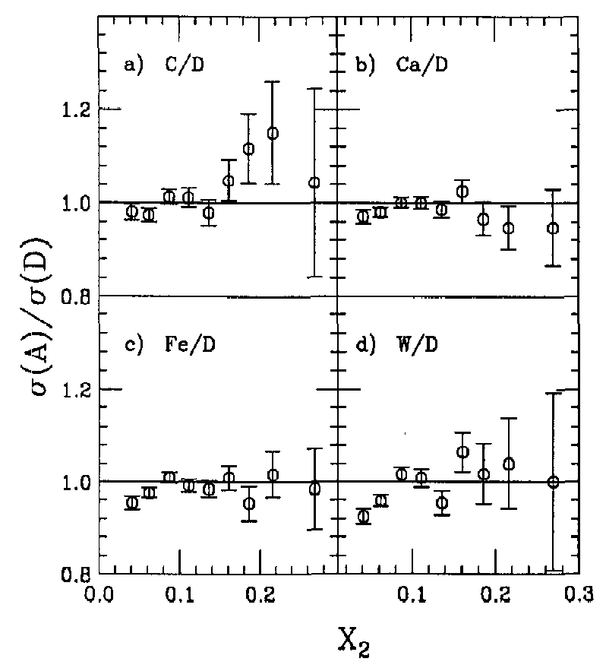
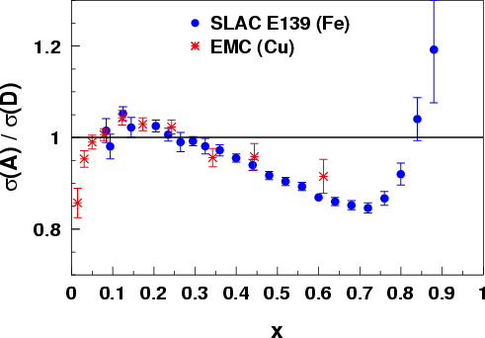
Quarks & Anti-Quarks in Nuclei
F₂ structure functions, or quark distributions, are altered in nuclei
~1000 papers on the topic; the best models explain the curve by change of nucleon structure - BUT we are still learning (e.g. local density effect)
Drell-Yan: Is the EMC effect a valence quark phenomenon or are sea quarks involved?
E772
F₂^{A}/F₂^{D}
x

Slide 39
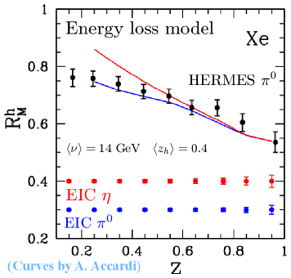
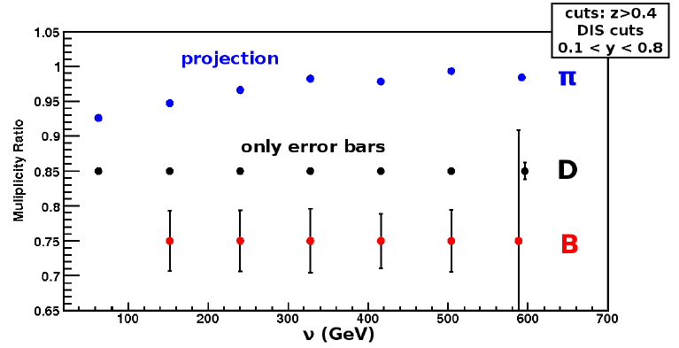
Hadronization
EIC: Explore the interaction of color charges with matter
(1 month only)
EIC: Understand the conversion of quarks and gluons to hadrons through fragmentation and breakup

